Slide 1
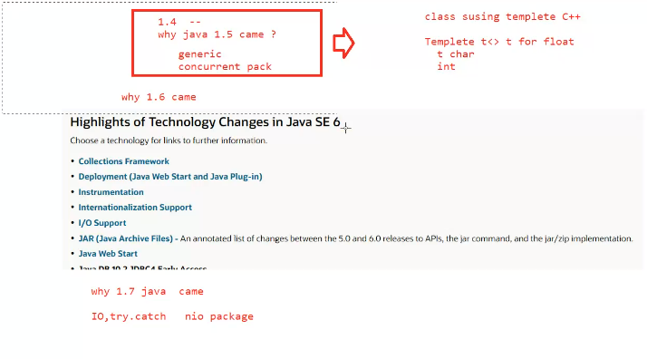

Slide 2
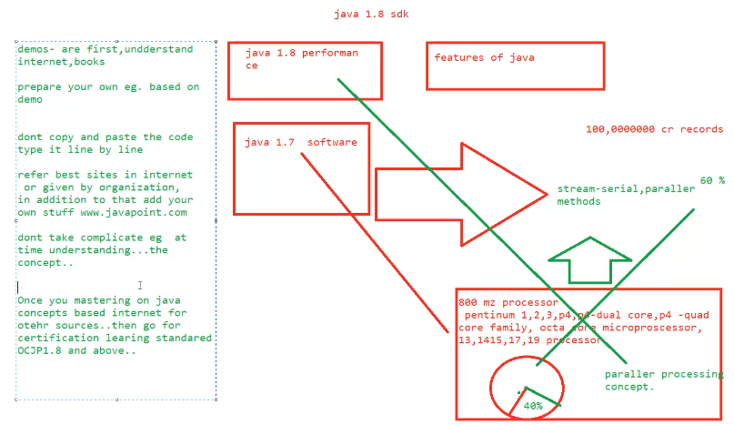

Slide 3
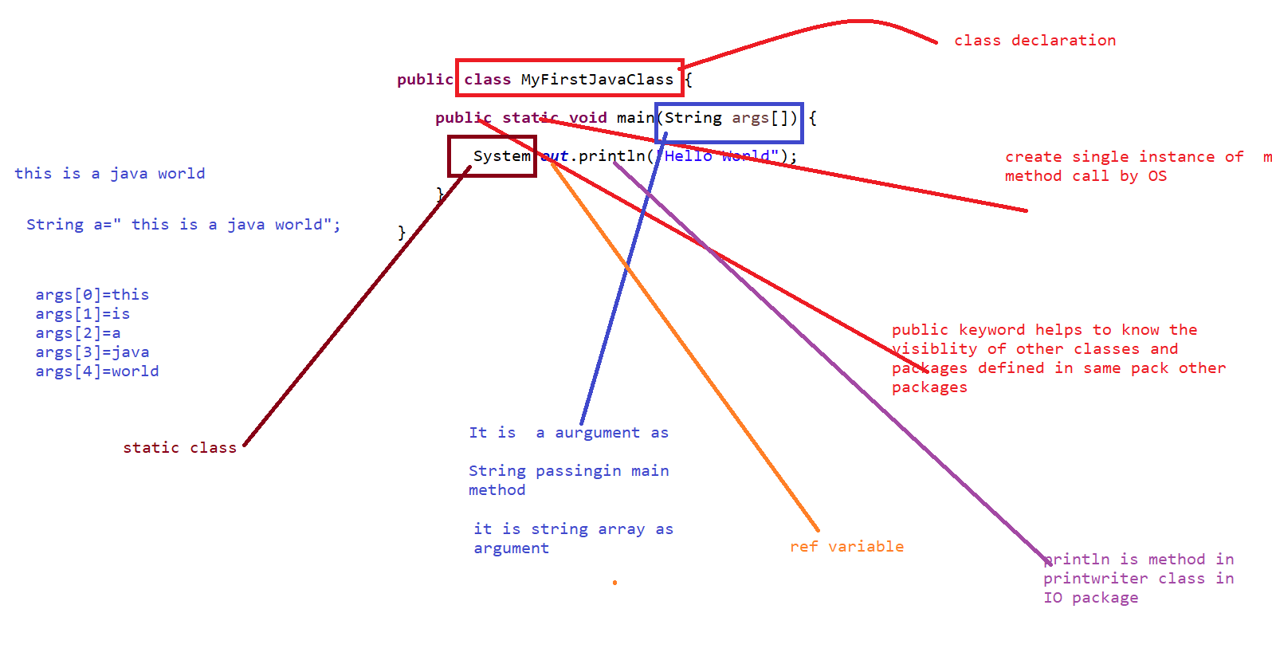

Slide 4
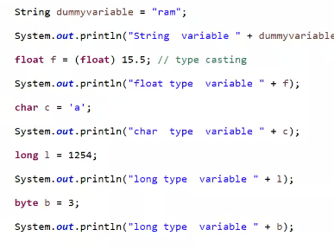
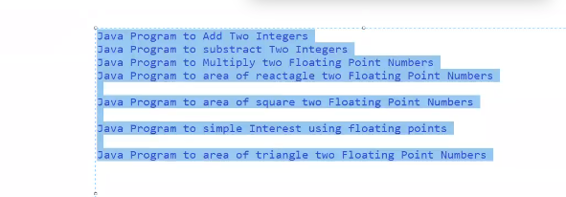
Java Program to Add Two Integers Java Program to substract Two Integers Java Program to Multiply two Floating Point Numbers
Java Program to area of reactangle two Floating Point Numbers
Java Program to area of square two Floating Point Numbers
Java Program to simple Interest using floating points
Java Program to area of triangle two Floating Point Numbers

Slide 5
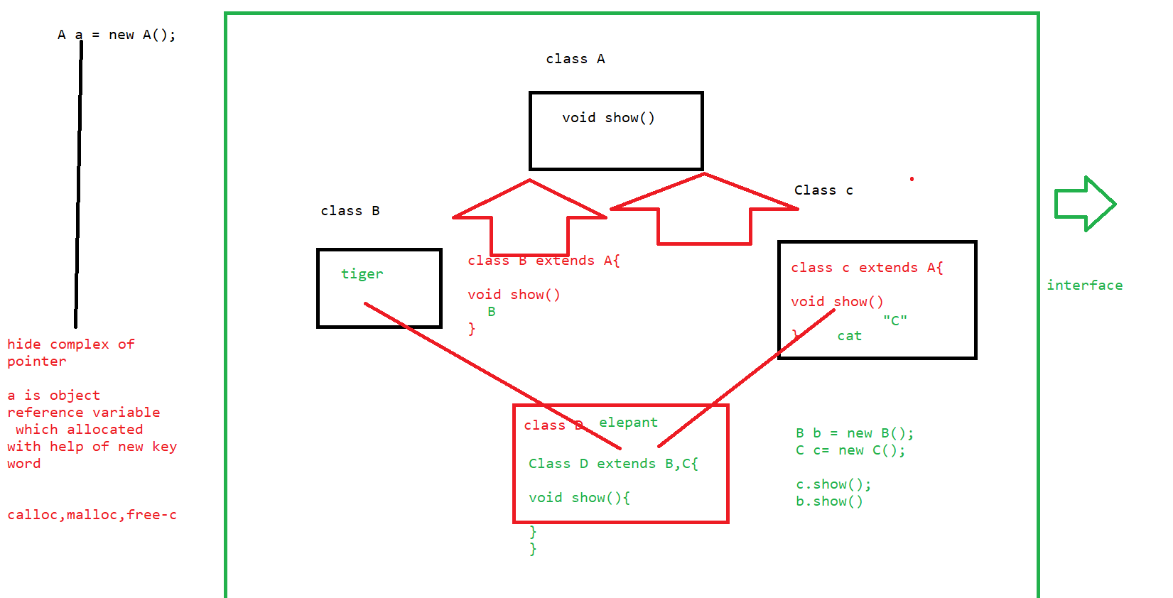
Diamond problem

Slide 6
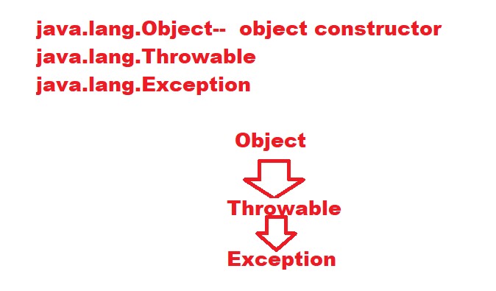

Slide 7
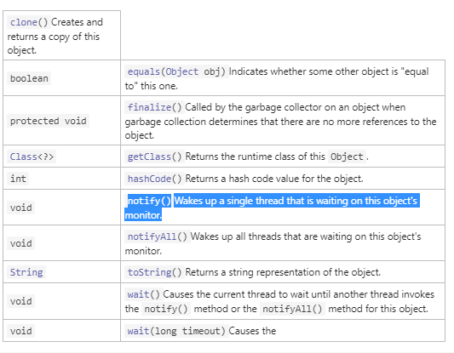
Class A{
try{
A a =new A();
a=show().
...logic
}
catch(Exception e){
}
finally{
a=null; // now this object is free to memory call by garbage collector
}

Slide 8
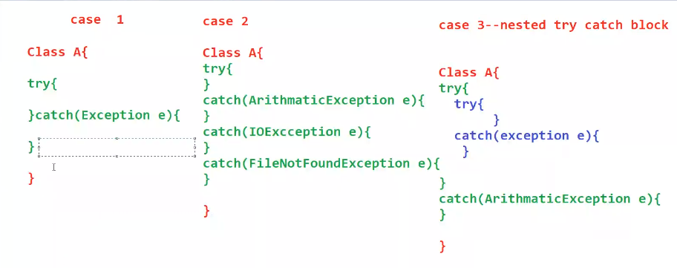

Slide 9
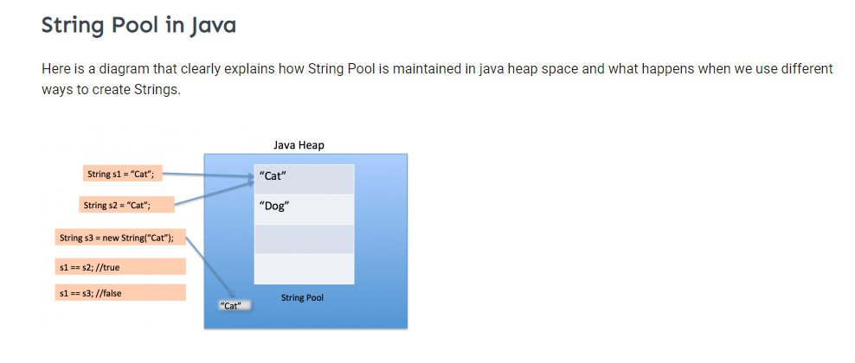
String handling

Slide 10
(Guest)String charAt() String compareTo() String concat() String contains() String endsWith() String equals() equalsIgnoreCase()
)String indexOf() String intern() String isEmpty() String join() String lastIndexOf() String length() String replace() String replaceAll() String split() String startsWith() String substring() String toCharArray() String toLowerCase() String toUpperCase() String trim() String valueOf()

Slide 11
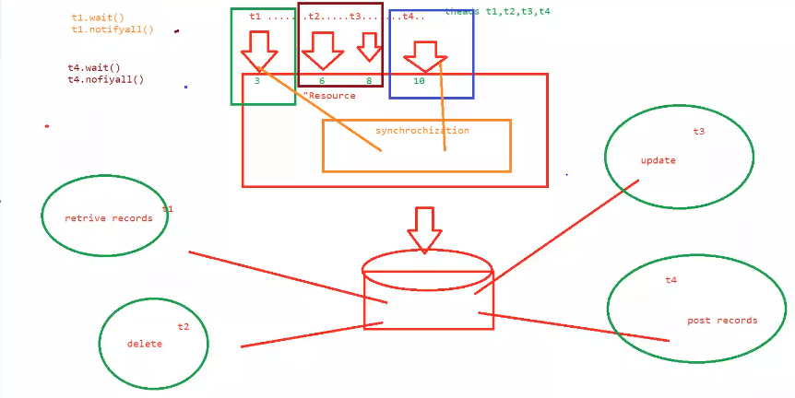

Slide 12
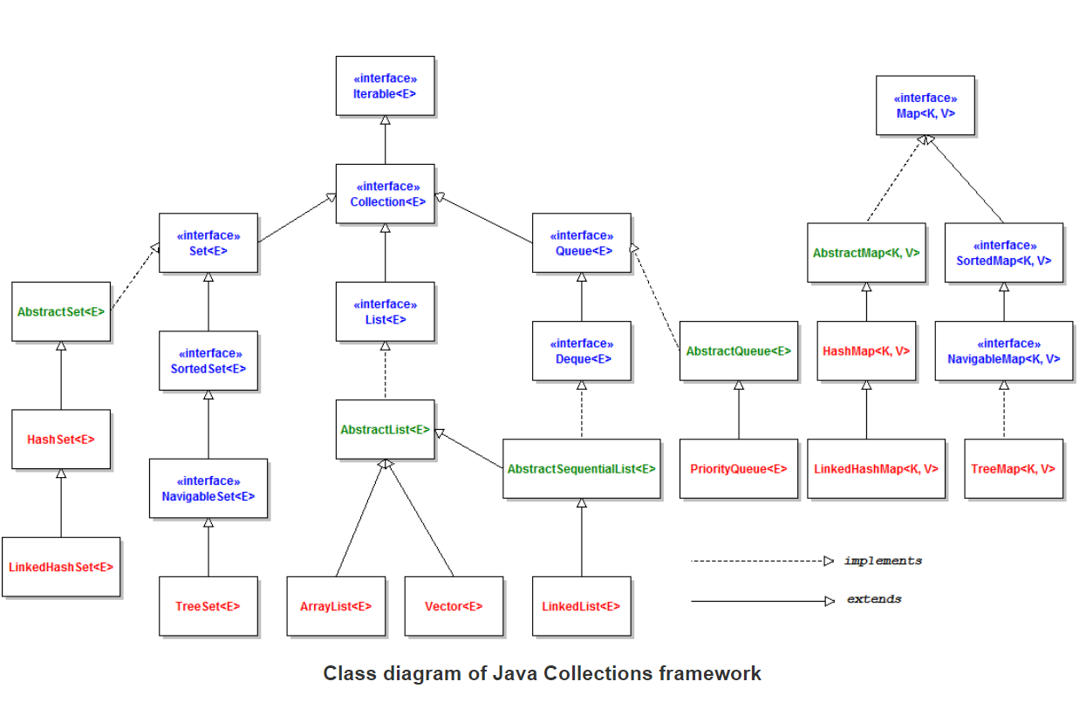

Slide 13
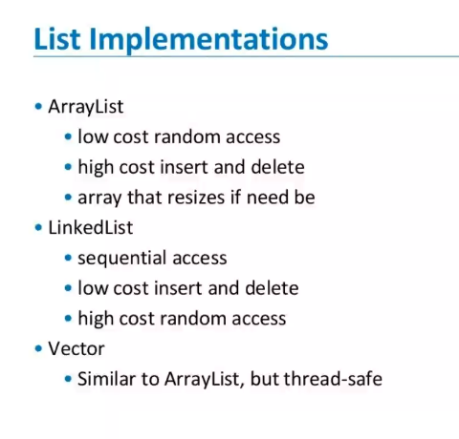
array list should be used if searching is used more..... linked list should be used if data is modified or updation is used more
Eg: Vector is used when we are login the form.

Slide 14
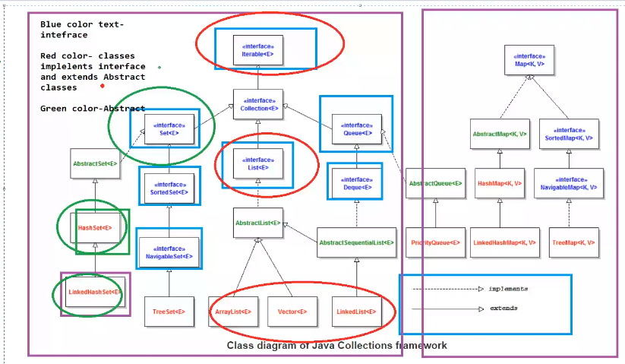

Slide 15
Write a Java program to get a list of all file/directory names from the given.
2. Write a Java program to get specific files by extensions from a specified folder.
3. Write a Java program to check if a file or directory specified by pathname exists or not.
4. Write a Java program to check if a file or directory has read and write permission.
5. Write a Java program to check if given pathname is a directory or a file.
6 Write a Java program to read contents from a file into byte array.
7 . Write a Java program to read a file content line by line.
8 . Write a Java program to read a plain text file.
9. Write a java program to read a file line by line and store it into a variable.

Slide 16
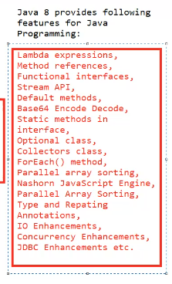
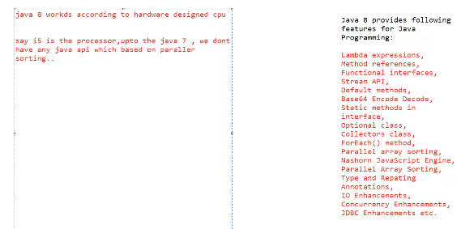
Java 8

Slide 17
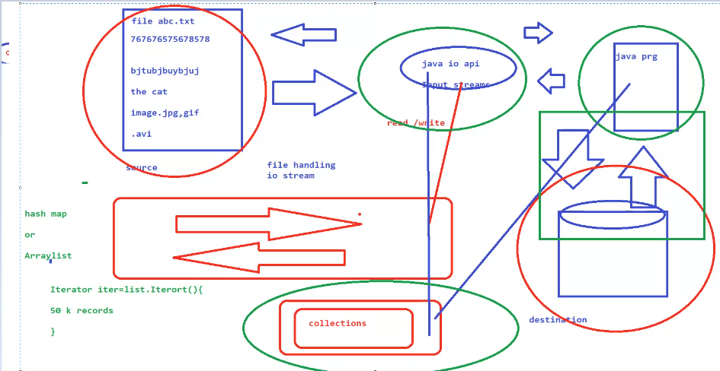

Slide 18
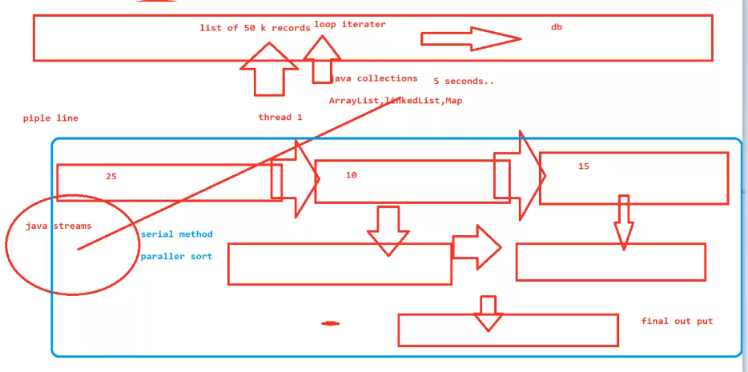

Slide 19
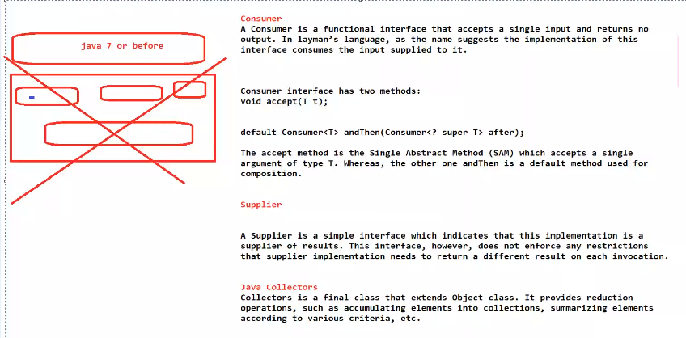

Slide 20
write a java program Filtering Collection without using Stream
write a java program Filtering Collection by using Stream
write a java v Stream Iterating Example
write a java program reduce() Method in Collection
write a java program Find Max and Min Product Price
write a java program count() Method in Collection
write a java program Convert List into Set

